Slide 1

A pathway to success
Cory Moyna & Azeb Mengstu
Hospital Tissue Viability Specialist & Vascular Nurse Specialist

Slide 2
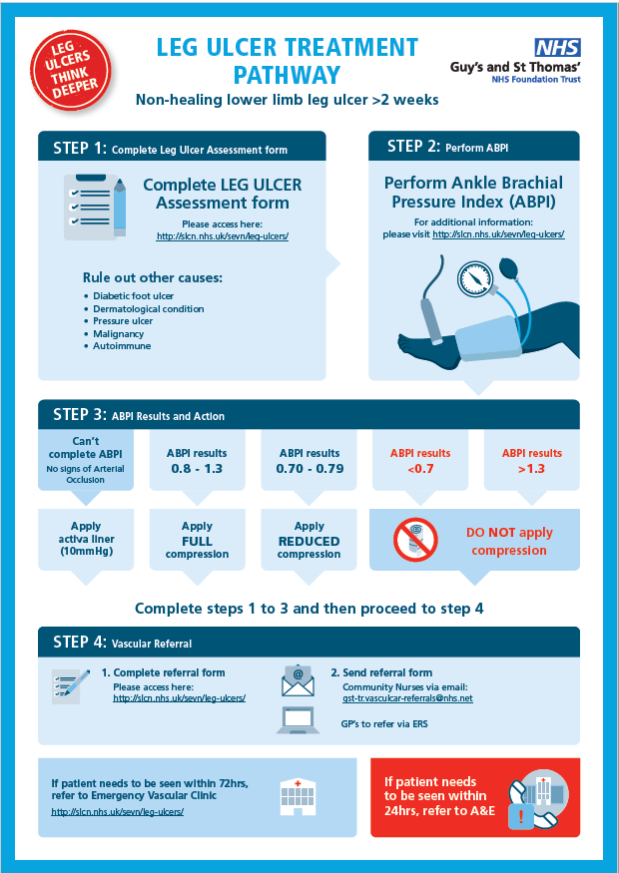






A pathway to success
Non-healing Lower limb leg Ulcer > 2wks
Complete the following 4 Steps:
Step1: Complete leg Ulcer assessment form
Step 2: Perform ABPI
Step 3: Depending on the results following
Correct compression guidance
Step 4: Complete Vascular referral form

Slide 3
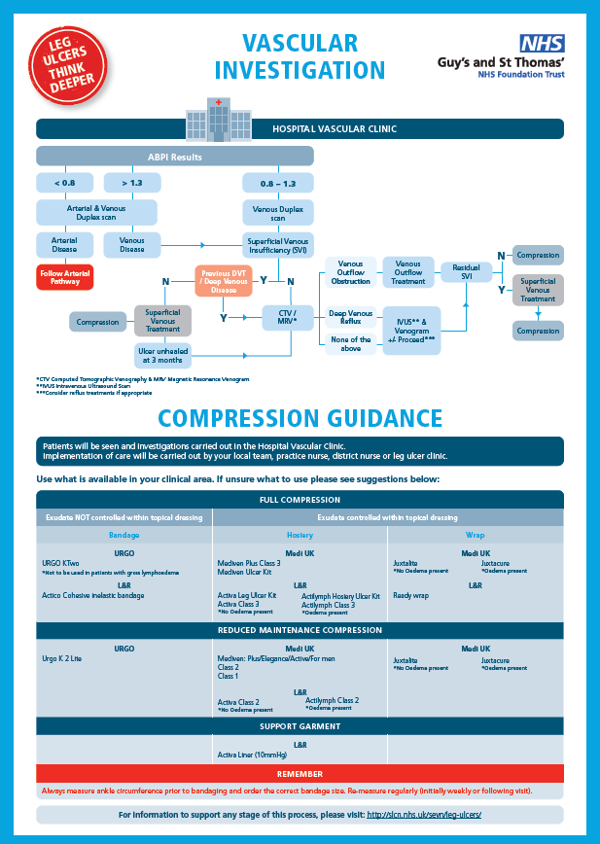

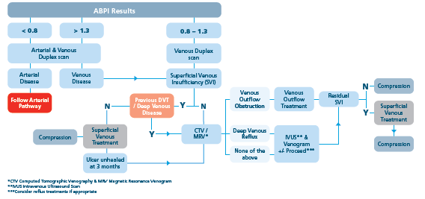
A pathway to success
Hospital Pathway

Slide 4
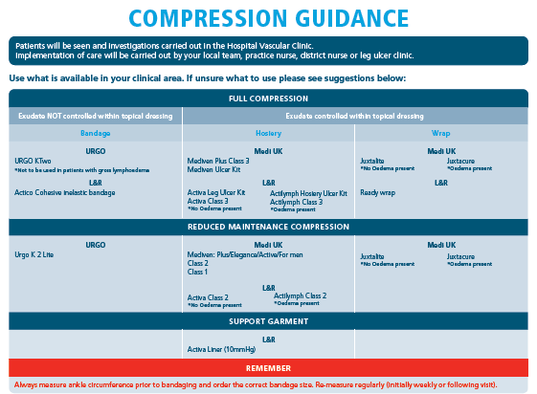
A pathway to success
Compression Guidance
Final Demonstration’s after event.

Slide 5
Patient Record

Slide 6
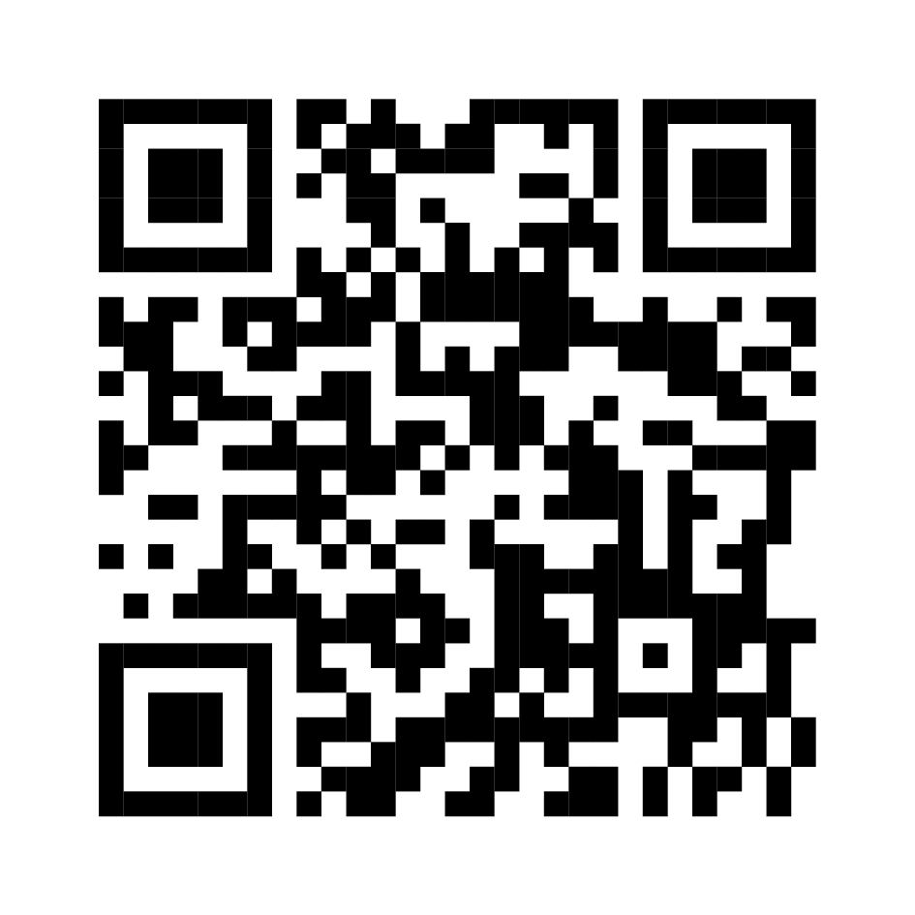
A pathway to success
www.slcn.nhs.uk/sevn/leg-ulcers/

Slide 7
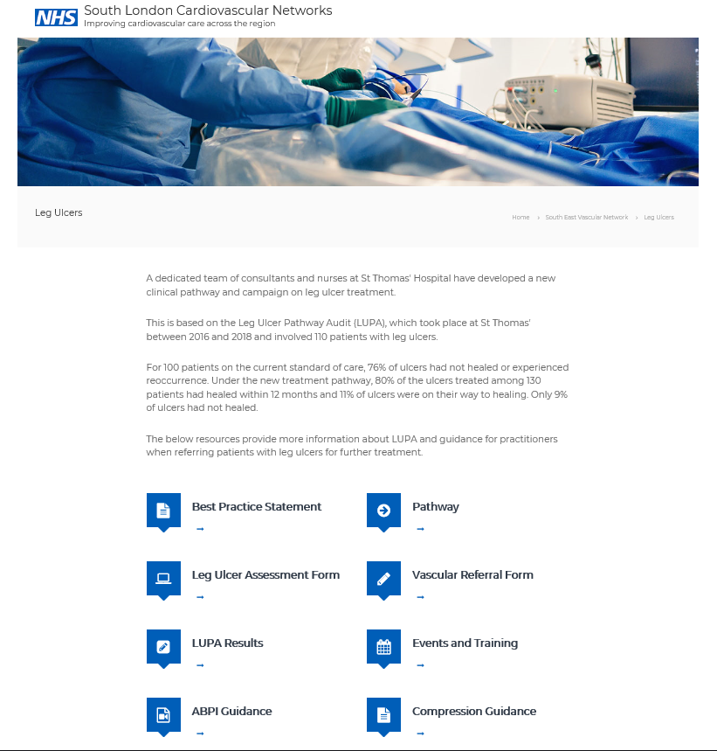
A pathway to success
Insert Image from Website here
www.slcn.nhs.uk/sevn/leg-ulcers/

Slide 8
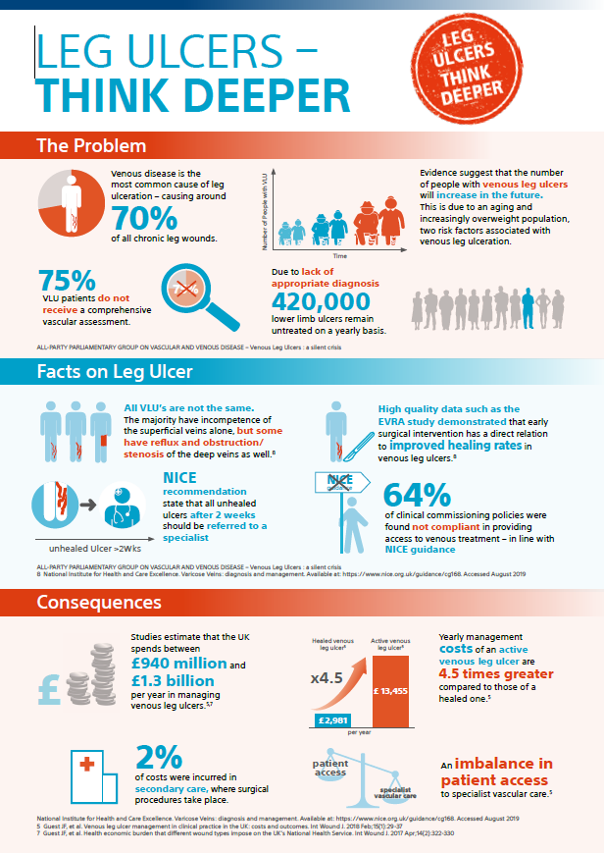
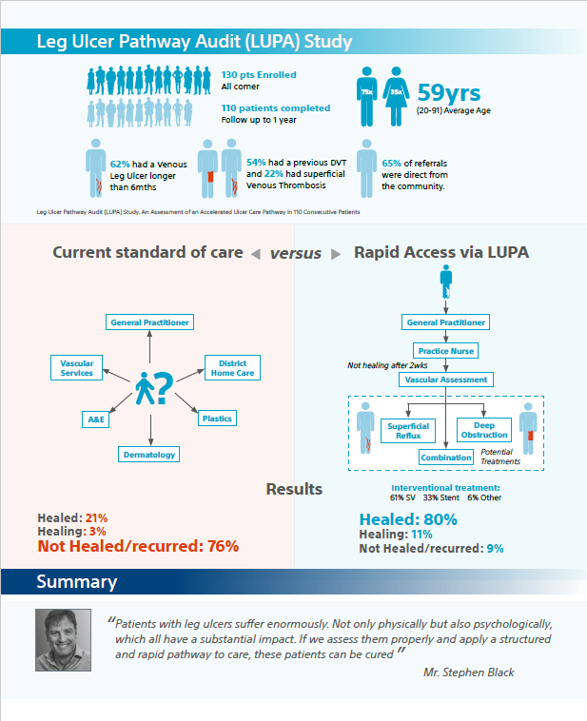
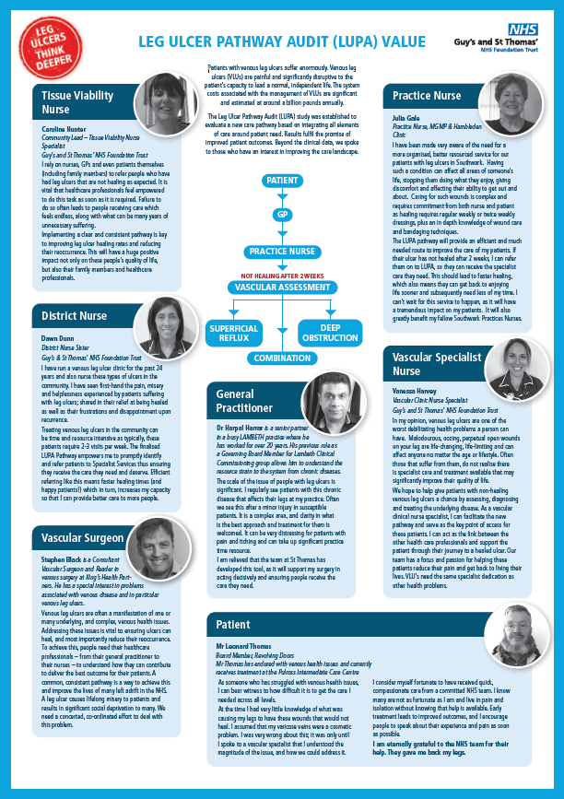

Packs:
Copy of the pathway
LUPA Results
LUPA added value
Presentation
Silent Crisis & summary
Think Leg Ulcer Think Deeper:
Posters
Pens
Post its
Note Books

Slide 9
Leg Ulcer Testimonials

