Slide 1
Barriers to effective Leg Ulcer care
Vanessa Harvey
Vascular Clinical Nurse Specialist

Slide 2
Current Leg Ulcer Management Challenges
Patients not getting a differential diagnosis
Lack of early treatment
Current pathways are lengthy and sometimes delay treatment
Lack of surgical treatment awareness
Prevention of recurrence
Notes:
there is a lot of evidence behind compression bandaging, and leg ulcers classically treated by nurses. compression is still the gold standard, but sometimes is there something more we can be doing for these patients? Using new technology and new skills to treat underlying disease.

Slide 3
56% of people with VLUs do not get a differential diagnosis Guest JF, et al (2015)
c
Challenge of getting the diagnosis
Referral confusion
Vascular Assessment
TVN
Practice Nurse
Plastics
ABPI does not diagnose Venous disease
?
?
Vascular
Derm
District Nurse
?
?
Notes:
there is a lot of evidence behind compression bandaging, and leg ulcers classically treated by nurses. compression is still the gold standard, but sometimes is there something more we can be doing for these patients? Using new technology and new skills to treat underlying disease.

Slide 4
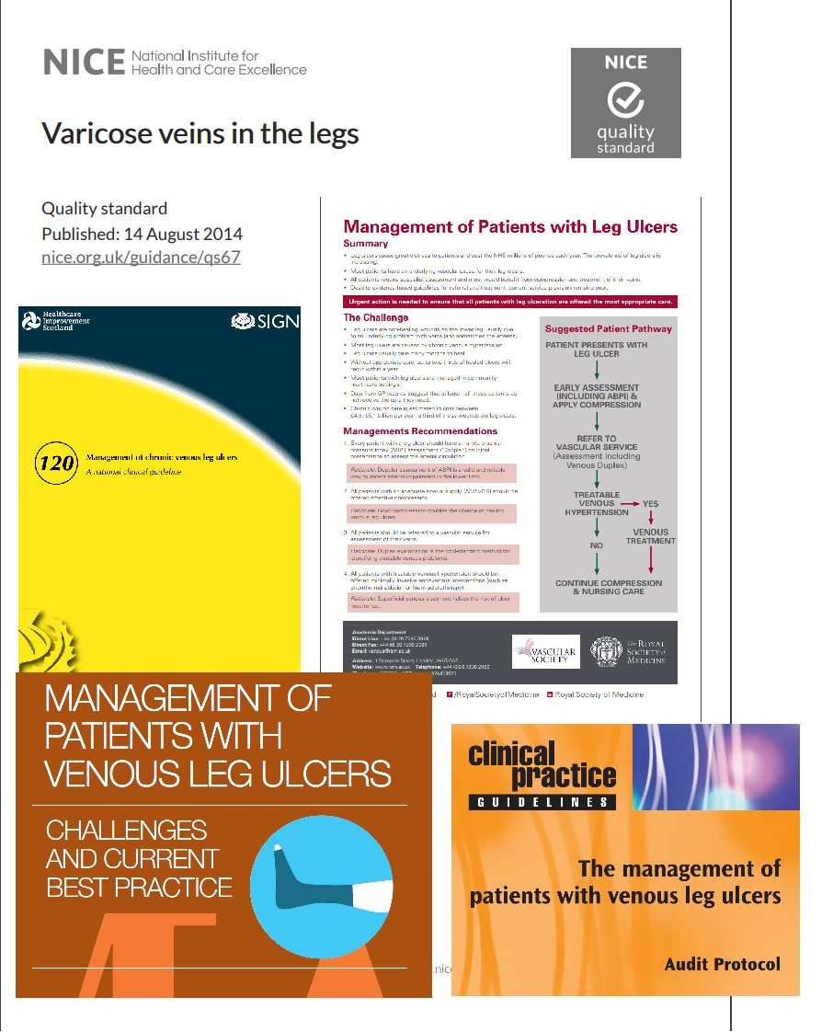
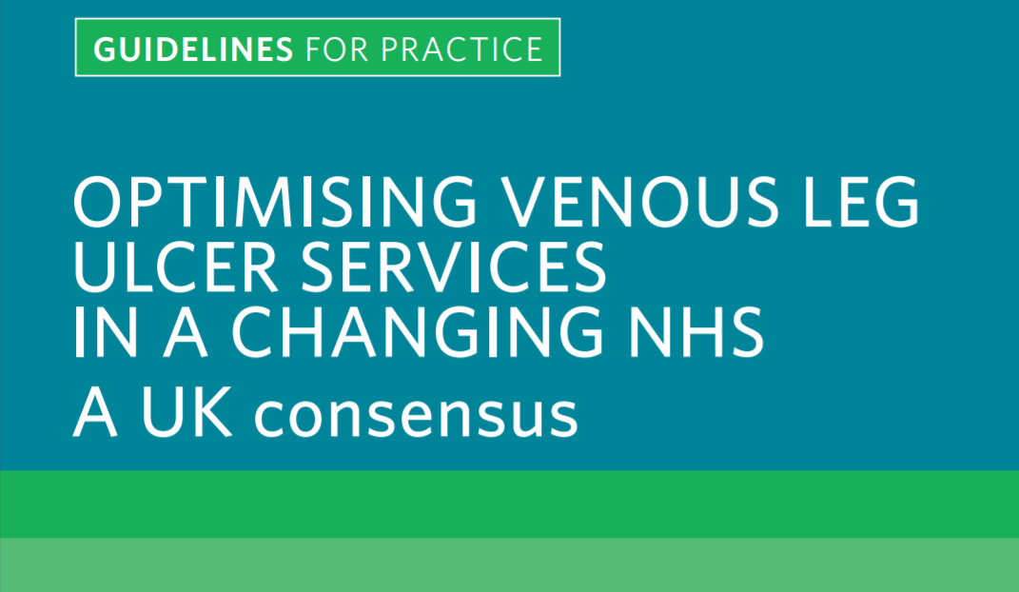
Heading 28pt Calibri
Notes:
there is a lot of evidence behind compression bandaging, and leg ulcers classically treated by nurses. compression is still the gold standard, but sometimes is there something more we can be doing for these patients? Using new technology and new skills to treat underlying disease.

Slide 5
Lack of early treatment and resources
Associated treatment costs
Location of specialist clinics
Short on time
Nurses trained in compression
Notes:
-Referral to the hospital is expensive, treatment is expensive - but is it?
-location - too far for the patient to travel
-not enough time or people
Who looks after leg ulcers?
Practice nurse? TVN? plastics nurse? Family member?
Impact of EVRA

Slide 6
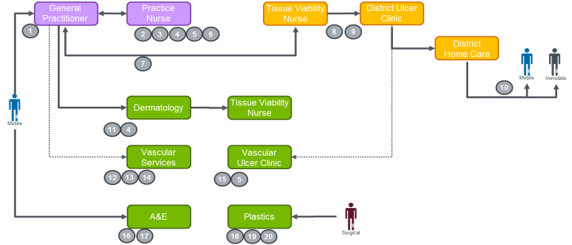
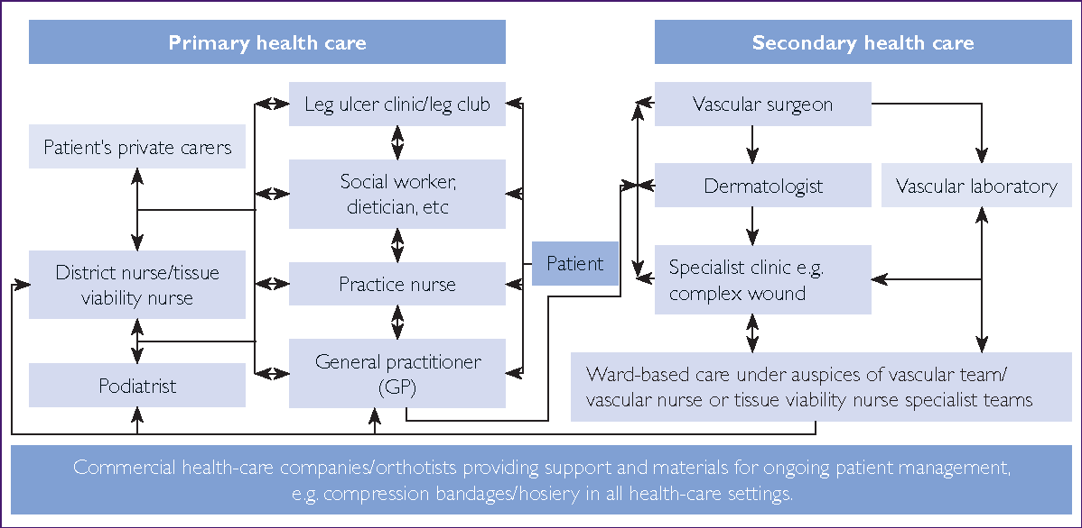
Culture of current pathways
Franks, Barker et al. (2016) Management of Patients with VLUs.
Notes:
there is a lot of evidence behind compression bandaging, and leg ulcers classically treated by nurses. compression is still the gold standard, but sometimes is there something more we can be doing for these patients? Using new technology and new skills to treat underlying disease.

Slide 7
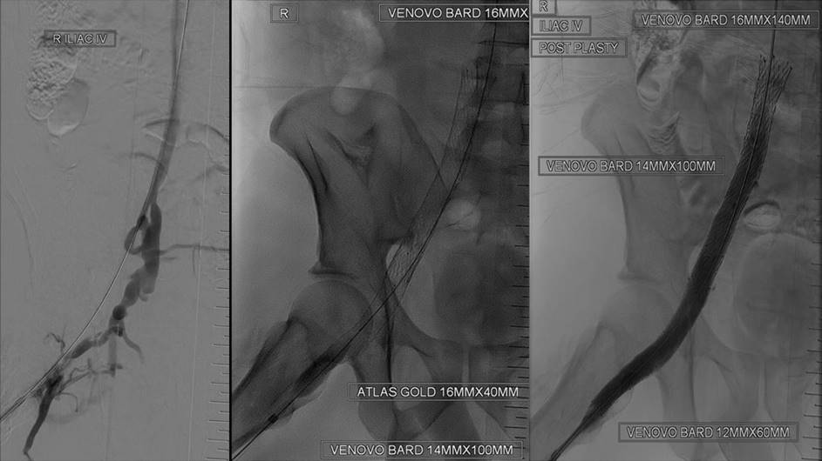
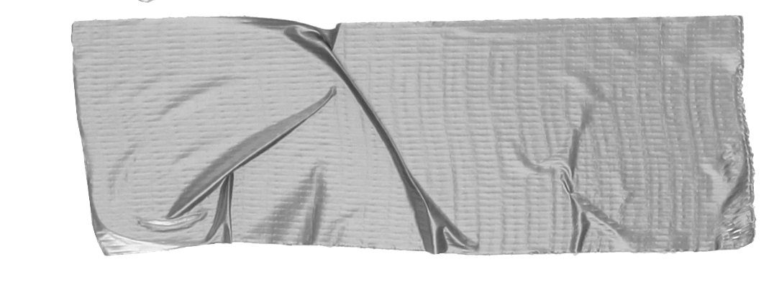
Inequality of care
Surgical treatment options are not offered the same way everywhere
Variations in support: from leg clubs to ulcer clinics
Variation in clinical nurse specialist support
Access to information and surgical treatment options is limited for patients
Notes:
there is a lot of evidence behind compression bandaging, and leg ulcers classically treated by nurses. compression is still the gold standard, but sometimes is there something more we can be doing for these patients? Using new technology and new skills to treat underlying disease.

Slide 8
Prevention of recurrence and MDT collaboration
Notes:
health care teams need to work together to make this work. The GP/Practice nurses need to make the referrals, ongoing wound advice from TVNs, and assessment and diagnosis/treatment if required from a vascular specialist for lower limb wounds.

Slide 9
To do this we needed a little TLC
2 years of pathway implementation and data collection to prove it works
Team of motivated people who wanted to help those suffering from VLUs
Attention to detail
Time
Love
Care
Notes:
-time
2 years of implementation and data collection to prove it works
-love
-team of motivated people who want to help those suffering from VLUs
-care
-attention to detail and dedication to the project

Slide 10
Leg Ulcer Pathway Audit
Patients Identified
Large cohort of patients suffering from VLUs
Timely diagnostics and vascular assessment
ABPI, Duplex ultrasound, MR Venogram or CT Venogram to check for superficial venous reflux & outflow obstruction, or arterial disease
Vascular Assessment
Includes clinical, wound and quality of life assessments
Differential diagnosis with treatment plan
Possible surgical treatment options of stenting, superficial venous ablation, or compression
Follow up and wound management
Monitor wound healing; complete quality of life assessment, stent patency checks
Notes:
there is a lot of evidence behind compression bandaging, and leg ulcers classically treated by nurses. compression is still the gold standard, but sometimes is there something more we can be doing for these patients? Using new technology and new skills to treat underlying disease.
-a large cohort of patients suffering from VLUs
-easy vascular referral
-comprehensive assessment including wound assessment and vascular diagnostics
-abpi
-venous duplex (arterial duplex if indicated)
-MR Venogram if history of DVT or recurrent varicose veins
-differential diagnosis with treatment plan
-if underlying deep venous pathology, venogram with intention to stent if applicable
-treatment of superficial reflux if applicable
follow up for 1 year after treatment
-monitor wound healing, symptoms, stent patency
AIM: Through the LUPA expedited pathway we can improve outcomes and financial savings

Slide 11
How we did this
Industry collaboration
Additional specialist nurse
Stakeholder network
Collect and analyse data
Disease state mapping, project management assistance and funding support from Boston Scientific
Employed vascular clinical nurse specialist to implement pathway and run nurse led clinic
Strengthened relationships with local care teams and GSTT acute specialties
Tracked patients along the pathway, with assistance of remote patient monitoring app, monitor healing rates and QoL.
1
2
3
4
Notes:
industry collaboration with Boston Scientific with funding support
employed CNS to lead project
create a network of stakeholders
monitor and collect data on patients in the pathway

Slide 12
Challenges to LUPA
Outpatient clinics
Ultrasonic angiology
Capacity
Theatre
Key challenges
Electronic patient records
Technology
Medopad remote patient monitoring
Notes:
resources
-clinic space to see the patients
-capacity for investigations
-theatre capacity
-GSTT electronic patient records outdated, difficult to track patients through pathway

Slide 13
Goals
Improve Outcomes
Financial Savings
Wound
healing
Quality
of Life
Pain

Slide 14
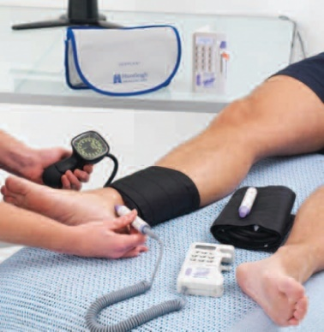
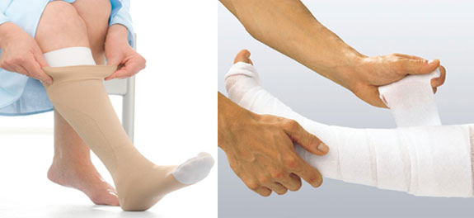
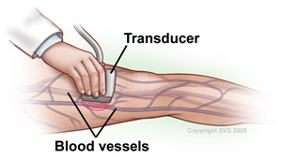
By delivering an optimal care pathway the economic burden can be 10 times less, and the time to healing can be reduced from years to only a few months (Betty’s Story, 2017)

