Slide 1

South East London
Medicines Optimisation in CVD
Rachel Howatson, Senior Cardiovascular Pharmacist
Helen Williams, Consultant Pharmacist for CVD
^{14th Sept 2021}

Slide 2

Plan
Heart failure case study
Q&A
Atrial Fibrillation case study
Q&A
Acute Coronary Syndrome case study
Q&A
Mentimeter poll throughout: Mentimeter app or www.mentimeter.com code 3237 3703
https://www.menti.com/z38uhr46vd

Slide 3

Case study 1: George
Aged 70 years
HFrEF (LVEF 35%)
CHD: MI 8 years ago, TIIDM, HT
Retired plumber lives with wife, Agnes
Enjoys playing golf- regular 18 hole rounds
Has come to surgery for a review…
BP 155/90
Pulse 70bpm regular
NYHA II, slight decline last 6 months
Struggling with SOB when plays golf
No peripheral oedema, PND/orthopnoea
Chest sounds clear and no chest pain

Slide 4

What symptoms of worsening HF affect George?
SOB when plays golf
Peripheral oedema
Chest pain
All of the above
None of the above

Slide 5
Case study: George
Medications:
Enalapril 10mg twice daily
Bisoprolol 5mg daily
Furosemide 40mg morning
Aspirin 75mg morning
Atorvastatin 80mg night
Amlodipine 5mg morning
Metformin 500mg twice daily
Bloods: Normal
Cr 90micromols/L
eGFR >60ml/min, K 4.4mmol/L
HbA1c 45mmol/mol
TC 3.4mmol/L
LDL 1.4mmol/L

Slide 6

What actions could be taken?
Increase diuretic dose to 80mg daily?
Increase enalapril dose?
Increase bisoprolol dose?
All of the above at the same time
No action required

Slide 7
Loop diuretics: furosemide or bumetanide
Aim to obtain / maintain dry weight
(furosemide 40mg ≈ 1mg bumetanide)
Fluid overload: One or more of the following:
Weight ↑ >1.5kg above dry weight/rapid weight gain over 2-3 days
↑dyspnoea / ↑peripheral oedema or sacral oedema / orthopnoea and/or paroxysmal nocturnal dyspnoea (PND)
Add or increase diuretic dose (check baseline U&Es- keep K 3.6-5mmol/L, Na>130mmol/L)
Dehydration: Two or more of the following:
Weight ↓ >1.5kg below dry weight over 2-3 days
No symptoms of ↑ dyspnoea or peripheral oedema
Symptoms of thirst, dizziness, or feeling washed out
Decrease diuretic dose (check baseline U&Es, BP- symptomatic SBP <100mmHg)

Slide 8
HFrEF management
LVEF ≤40%
First line:
ACEI eg ramipril or ARB if intolerant eg candesartan
Beta blockers eg bisoprolol
Uptitrate to maximum tolerated doses
Check BP, HR U&Es, CrCl
Second line:
MRA eg spironol-actone
Uptitrate to maximum tolerated dose
Check K <5.5mmol/L at regular intervals

Slide 9
NICE Quality statement
People with chronic heart failure due to left ventricular systolic dysfunction are offered angiotensin-converting enzyme inhibitors (or angiotensin II receptor antagonists licensed for heart failure if there are intolerable side effects with angiotensin-converting enzyme inhibitors) and beta-blockers licensed for heart failure, which are gradually increased up to the optimal tolerated or target dose with monitoring after each increase
www.nice.org.uk
Notes:
Helen

Slide 10
Limitations to uptitration:
ACE Inhibitors
Symptomatic hypotension
Worsening renal function (increasing creatinine or potassium)
Dizziness
Persistent, intolerable dry cough that interferes with sleep
Beta-blockers
Symptomatic hypotension
Bradycardia
Evidence of reversible airways disease
Tiredness / fatigue
Weight gain due to increased congestion
Erectile dysfunction

Slide 11

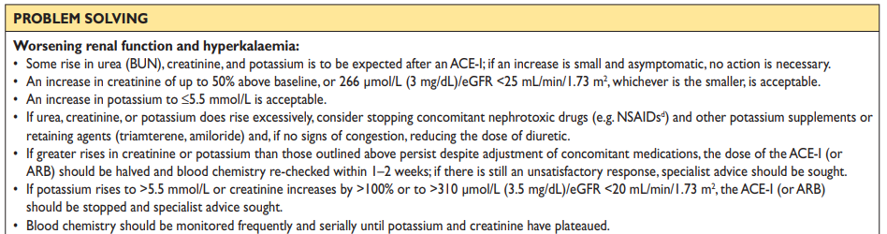
ACEI / ARB – renal monitoring
ESC HF guidance 2016: Web Addenda Supplementary data https://academic.oup.com/eurheartj/article/37/27/2129/1748921#109987318

Slide 12
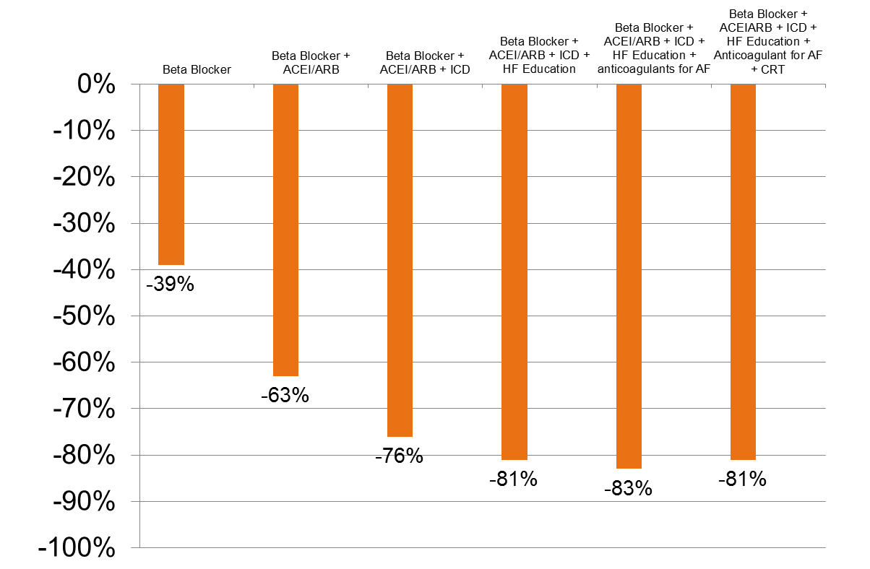
Incremental Benefits with HF Therapies
(Cumulative % Reduction in Odds of Death at 24 Months)
-28% to -49%
P<0.0001
-54% to -71%
P<0.0001
-68% to -81%
P<0.0001
-75% to -86%
P<0.0001
-77% to -88%
P<0.0001
-72% to -87%
P<0.0001
Fonarow GC, et al. J Am Heart Assoc. 2012;1:16-26.

Slide 13

Points to consider
Are medicines and doses suitable?
  consider dose uptitrations of prognostic HF meds
  consider contra-indications and co-morbidities
What questions would you ask?
What issues need to be addressed?
What are the priorities?
What assessments and investigations are required?

Slide 14
What are possible further options following optimisation of ACEI and BB?
Add in spironolactone
Add in dapagliflozin
Both of above
Change ACEI to sacubitril/valsartan
No action required

Slide 15
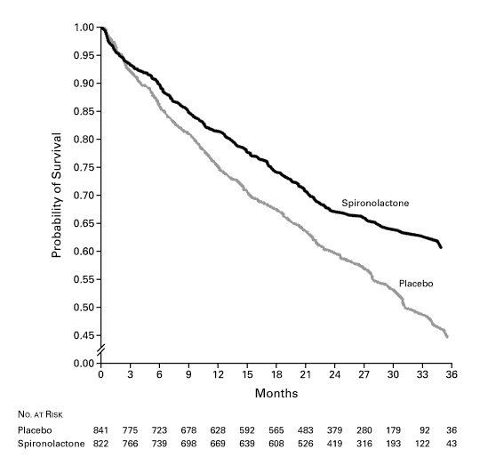
Spironolactone
RALES study NEJM 1999; 341 (10), 709-717
Significant reduction in mortality:
  35% (active) cf. 46% (placebo); p=0.001
  reduction in progressive HF and sudden death
  Reduction in hospitalisations

Slide 16
Action taken
After discussion with George, spironolactone is started 25mg daily
  Improves prognosis (mortality and hospitalisation risk)
  Improves SOB symptoms and quality of life
Follow up within 1-2 weeks:
  Check progress
  Check bloods- eGFR, K
What other changes would be appropriate?
  Optimise beta blocker if clinically stable- aim resting pulse 60bpm
  Optimise ACEI to enalapril 20mg BD if BP and renal function allows
  BP control should improve with these changes- review need for amlodipine
  If George remains NYHA II, may be suitable for sacubitril/valsartan or dapagliflozin

Slide 17
Next steps
1 month later, medication changes:
  Enalapril 20mg BD
  Bisoprolol 10mg OD
  Spironolactone 50mg OM
Observations: BP 140/80, HR 65 bpm regular
Investigations: eGFR >60ml/min, K 5mmol/L
Patient ET: Less SOB but still struggles to complete 18 holes in golf
Medicines optimisation
  Stop amlodipine
  Start dapagliflozin 10mg daily
Follow up within 3 months: eGFR, HbA1c, BP

Slide 18
NICE guidance for dapagliflozin Feb 2021
Dapagliflozin is recommended as an option for treating symptomatic chronic heart failure with reduced ejection fraction in adults, only if it is used as an add-on to optimised standard care with:
angiotensin-converting enzyme (ACE) inhibitors or angiotensin‑2 receptor blockers (ARBs), with beta blockers, and, if tolerated, mineralocorticoid receptor antagonists (MRAs), or
sacubitril valsartan, with beta blockers, and, if tolerated, MRAs.
Start treatment of symptomatic heart failure with reduced ejection fraction with dapagliflozin on the advice of a heart failure specialist. Monitoring should be done by the most appropriate healthcare professional.

Slide 19
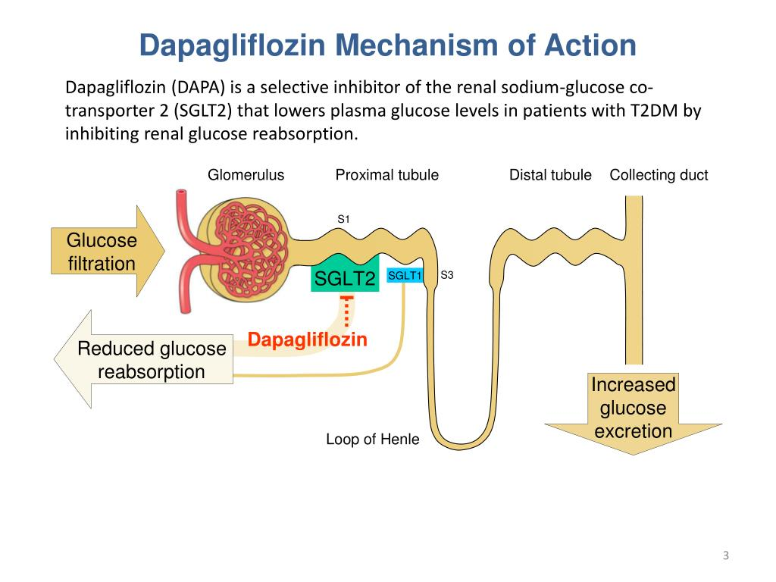

Slide 20

Primary composite outcome
CV Death/HF hospitalization/Urgent HF visit
Diabetes
No Diabetes
HR 0.75 (0.63,0.90)
Placebo
Placebo
HR 0.73 (0.60,0.88)
Placebo
Dapagliflozin
Dapagliflozin
Dapagliflozin
P interaction 0.80

Slide 21
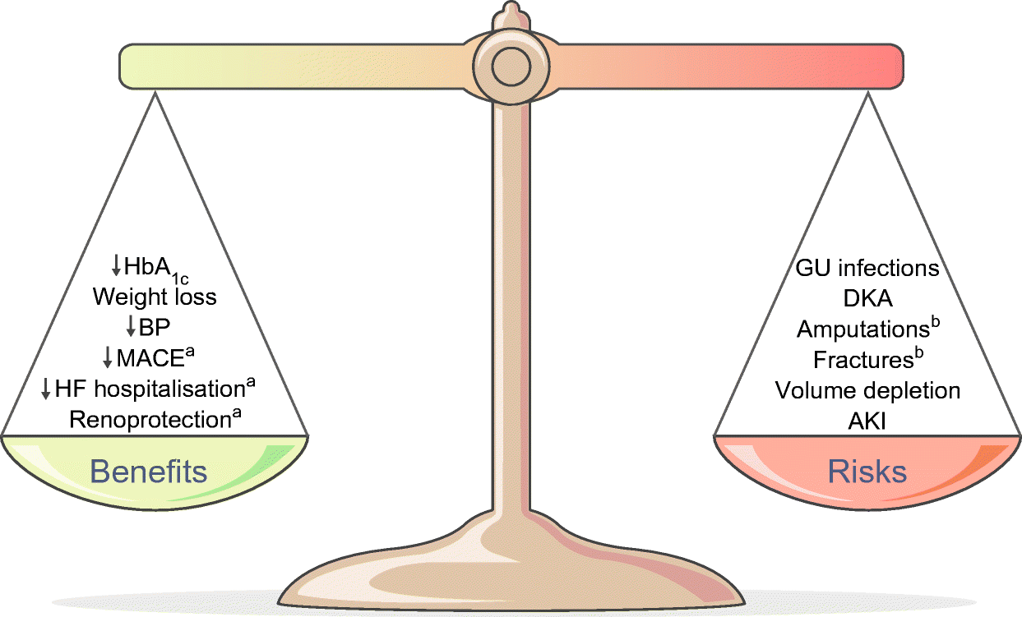
Dapagliflozin/SGLT2is

Slide 22
DAPAGLIFLOZIN- CONSIDERATIONS
Is it for HF in DM or non-DM?
Update primary care record and schedule follow ups
Check BP at initiation, within 3 months and 6 monthly
Check renal function at initiation, within 3 months and annually
Check HbA1c at initiation and 3 months
Check liver function at initiation
Patient counselling/adherence
Monitor side effects and HF symptoms
DKA awareness: know signs and symptoms
MHRA: SGLT2 inhibitors (canagliflozin, dapagliflozin, empagliflozin): risk of diabetic ketoacidosis - GOV.UK (www.gov.uk)
SEL guidance: https://www.lambethccg.nhs.uk/news-and-publications/meeting-papers/south-east-london-area-prescribing-committee/Documents/Cardiovascular%20Disease%20Guidelines/Heart%20Failure%20Dapagliflozin%20HFrEF%20non-DM%20FINAL%20July%202021.pdf

Slide 23
Sacubitril Valsartan (NICE TA388)
Sacubitril valsartan is recommended as an option for treating symptomatic chronic heart failure with reduced ejection fraction, only in people:
  with New York Heart Association (NYHA) class II to IV symptoms and
  with a left ventricular ejection fraction of 35% or less and
  who are already taking a stable dose of angiotensin‑converting enzyme (ACE) inhibitors or angiotensin II receptor‑blockers (ARBs)
Specialist initiation and dose titration
Must ensure all other ACEI/ARB stopped

Slide 24
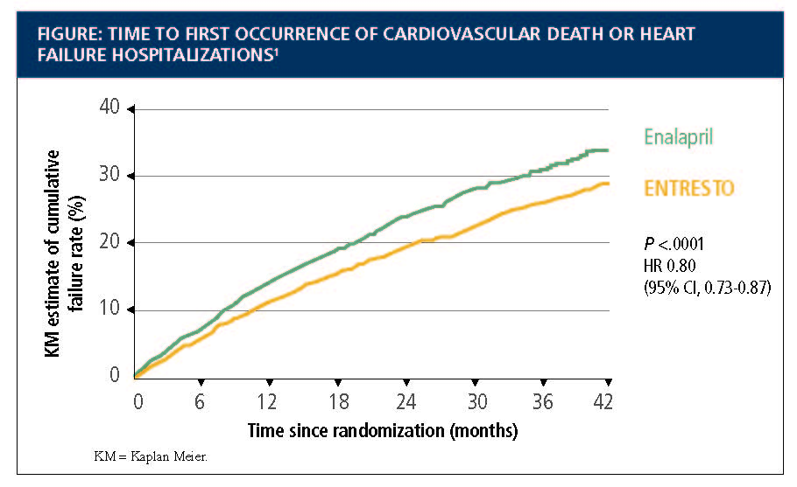
Paradigm-HF
McMurray JJ, Packer M, Desai AS, et al; PARADIGM-HF Investigators and Committees. Angiotensin-neprilysin inhibition versus enalapril in heart failure. N Engl J Med. 2014;371(11):993-1004

Slide 25

Sacubitril/valsartan- Considerations
Starting dose varies if ACEI/ARB naïve; eGFR <30 to 60ml/min
SBP >100mmHg, K <5.4mmol/L
LVEF ≤35%
NYHA class II to IV symptoms
ACEI/ARB stopped for 36 hours- angioedema risk
Is initiated, uptitrated and stabilised by HF specialist (NICE)
Maximum dose 97/103mg BD
Caution moderate liver impairment- dose adjustments
Angioedema in 0.5% in PARADIGM-HF study

Slide 26
How may we help HF patients?
Reduce hospital admissions (approx. 86,000 per year)
  1 year mortality post hospital admission 23.3%
  Generally HF survival rates ≈ some cancers
Monitor symptoms of HF (NYHA)- severity of SOB and ET- red flags
Monitor adverse effects of medications
  Review other medications such as NSAIDs/ nephrotoxic drugs/ diuretics/ K⁺ sparing diuretics etc.
  K⁺ supplements and Na+ substitutes
Reduce harmful medications and maximise prognostic medications- adherence
Regular review (NICE recommends at least 6 monthly)

Slide 27
Pathways and support
SEL CHF guidance:
  https://www.lambethccg.nhs.uk/news-and-publications/meeting-papers/south-east-london-area-prescribing-committee/Documents/Cardiovascular%20Disease%20Guidelines/Heart%20Failure%20adult%20treatment%20GL%20SEL%20FINAL%20July%202020.pdf
  Community HF teams
  A&G acute trusts
References:
  NICE guidance for dapagliflozin: https://www.nice.org.uk/guidance/TA679
  NICE guidance for sacubitril/valsartan: https://www.nice.org.uk/Guidance/TA388
Support for patients:
  Pumping marvellous: https://pumpingmarvellous.org/
  BHF: https://www.bhf.org.uk/

Slide 28

Case study 2: Peter
Aged 66 years
PMH: HT, T2DM
Medication: amlodipine 10mg daily, metformin 500mg BD
BP: 135/85 in clinic, weight 70kg
Irregular pulse on manual palpation, rate 78bpm
ECG: confirms AF
What action is taken next?
Rate/rhythm control
Anticoagulation

Slide 29

What should you check before starting anticoagulation?
Audience to add comments

Slide 30

Checks prior to starting anticoagulation
CHA2DS2VASc score
HASBLED or ORBIT score
Patient preference
Lifestyle factors
Renal function
Weight
Interacting medications
FBC
Liver function
Clotting screen
DOAC initiation and monitoring template SEL SEPT 2020 FINAL.pdf (lambethccg.nhs.uk)

Slide 31
Peter
CHA2DS2VASc score 3: equates to 3.2% risk of stroke per annum
HASBLED score 1 (age >65): 3.4% risk or 1.02 bleeds per 100 patient years
ORBIT score is 0: low risk group
https://www.mdcalc.com/orbit-bleeding-risk-score-atrial-fibrillation
Explain benefits: risks of anticoagulation
Peter is not keen to take warfarin -lot of monitoring visits
Disabled wife at home requires 24 hour care so reluctant to attend regularly for blood tests
Reassure that DOAC requires less monitoring
CrCl calculated as 62ml/min, lack of interacting drugs
Prescribed edoxaban 60mg daily, counselled and referred to CP for NMS
Coded AF on EMIS

Slide 32
When should Peter have his next renal function check in primary care?
1 month
6 months
12 months
2 years

Slide 33

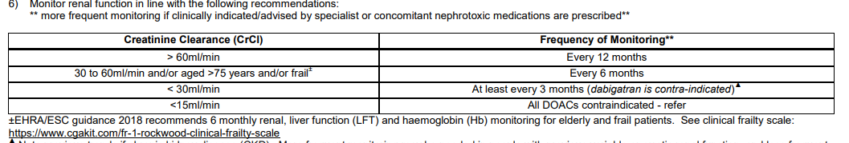
Calculating renal function for DOACs Sept 2019 FINAL.pdf (lambethccg.nhs.uk)

Slide 34
What should be checked at least annually for DOAC patients?
Audience to add text

Slide 35

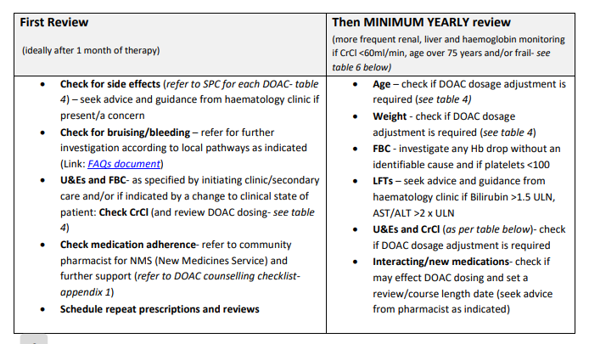
DOAC initiation and monitoring template SEL SEPT 2020 FINAL.pdf (lambethccg.nhs.uk)

Slide 36
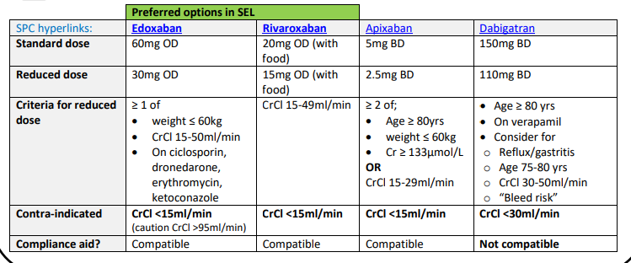
DOAC dosing adjustments (SEL guidance)

Slide 37
Peter
Rate v rhythm control?
Pulse rate 78bpm
No symptoms- no need for rate control
Rate control with beta-blocker (not sotalol) or RLCCB: aim for 90 to 110 bpm at rest
Choice according to symptoms, HR, comorbidities and preferences
Rhythm control: pharmacological and/or electrical for symptoms continue despite rate control- refer for specialist input
Amiodarone: rarely used now- initiation by specialist- often used ST around ablation/cardioversion/surgery- toxic side effects
  4 weeks before and up to 12 months post DCCV to maintain SR
  Continued 3 months post left atrial ablation to prevent AF recurrence
  6 weeks post CT surgery

Slide 38
Pathways and Support
SEL CVD guidelines: South East London Area Prescribing Committee (lambethccg.nhs.uk)
  DOAC initiation and monitoring guidance/template
  DOAC FAQs for primary care
  Renal monitoring for DOAC guidance
  Initiation of AC for NVAF guidance
  DOAC patient referral pathway for NVAF
AF pathway SLCN
NICE AF: diagnosis and management; https://www.nice.org.uk/guidance/ng196

Slide 39
Case study 3: Doris
56 year old, African-Caribbean heritage
Recent discharge post NSTEMI with PCI- DES to LAD artery
LVEF 60%
Smoker
Overweight BMI 31
TC 5.8mmol/L on admission, HDL 0.9mmol/L: non-HDL = 4.9mmol/L
Renal function: serum Cr 82micromol/L, eGFR 85ml/min
BP 156/96, HR 78bpm regular

Slide 40
Medication on discharge
Aspirin 75mg daily
Ticagrelor 90mg twice daily
Ramipril 2.5mg daily
Bisoprolol 2.5mg daily
Atorvastatin 80mg daily
Omeprazole 20mg daily
GTN spray 1-2 puffs PRN

Slide 41
Priorities on first review?
Audience to add thoughts..

Slide 42
Priorities on first review post NSTEMI
Check understanding of NSTEMI
Check mental and physical impacts
Lifestyle changes
Medication adherence
Protection from further events
Cardiac rehab
Set priorities and goals
Educate, support, encourage
Blood tests

Slide 43
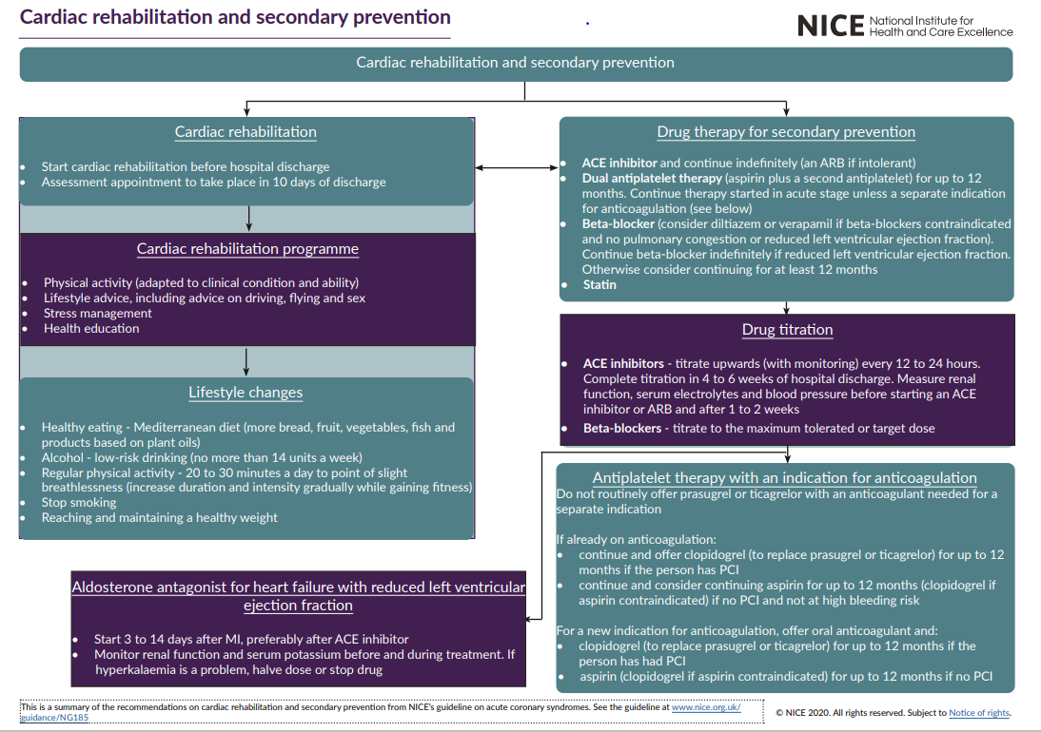

Slide 44
What treatment targets are we aiming for with lipids?
Total chol < 5mmol/L and LDL chol < 3mmol/L
Total Chol < 4mmol/L and LDL Chol < 2mmol/L
40% reduction in non-HDL cholesterol
Something else

Slide 45
Medicines optimisation post NSTEMI
DAPT review at one year- does not fulfil criteria to continue low dose ticagrelor
High dose high intensity statin- lifelong- explore attitudes to statins
Check lipid profile after 3 months, LFTs at 1 year
ACEI- continue indefinitely- dose titration and check renal function, potassium, BP
BB- continue for 1 year- titrate according to BP, HR and tolerance
Manage HT- confirm diagnosis with ABPM
Check for CP symptoms/GTN use
FU every few weeks during meds opt then annually

Slide 46

What happens at one year for antiplatelets?
Stop clopidogrel / prasugrel / ticagrelor and continue aspirin 75mg daily?
Continue / switch to low dose ticagrelor 60mg bd for a further three years? If meet DRAMA criteria
Consider switch to rivaroxaban 2.5mg bd with aspirin 75mg daily? If meet NICE/COMPASS criteria

Slide 47

COMPASS
Which Patients?
CAD (and high risk of ischaemic events)
  aged 65 or over or
  atherosclerosis in at least 2 vascular territories (such as coronary, cerebrovascular, or peripheral arteries), or
  2 or more of the following risk factors:
    current smoking
    diabetes
    kidney dysfunction with an eGFR of less than 60 ml/min
    heart failure
    Previous non-lacunar ischaemic stroke
Symptomatic PAD
Rivaroxaban plus aspirin compared to aspirin alone demonstrated a:
24% RRR in major CV events compared with aspirin
42% RRR in ischaemic stroke
22% for CV death
The committee concluded that rivaroxaban plus aspirin reduces the risk of cardiovascular events compared with aspirin alone, and that the greatest effect is for ischaemic stroke
https://www.nice.org.uk/guidance/ta607/chapter/1-Recommendations
*note that rivaroxaban is contraindicated if the eGFR is less than 15 ml/min

Slide 48
COMPASS
Exclusion criteria
High bleeding risk
Recent stroke (1 month) or previous haemorrhagic or lacunar stroke
Severe heart failure (LVEF <30%)
Advanced stable kidney disease (estimated GFR <15 ml per minute)
Use of dual antiplatelet therapy, anticoagulation, or other antithrombotic therapy
Non-cardiovascular conditions deemed by the investigator to be associated with a poor prognosis
Rivaroxaban plus aspirin compared to aspirin alone demonstrated a:
70% increased risk of major bleeding - the bleeds were mostly gastrointestinal
The committee concluded that rivaroxaban plus aspirin increases the risk of major bleeding compared with aspirin alone
https://www.nice.org.uk/guidance/ta607/chapter/1-Recommendations

Slide 49
Finding the Patients?
CAD
  Stable patients at annual review or via targeted searches
    All over 65 years
    Anyone with disease in more than one vascular bed
    Anyone with multiple risk factors
  BUT
    No recent acute coronary events / intervention
    No recent bleeds or risk factors indicating high bleeding risk
Symptomatic PAD
  Identification more complex; as not well coded in primary care
“People at high risk of ischaemic events and no known increased bleeding risk will have the most favourable benefit−risk profile”
https://www.nice.org.uk/guidance/ta607/chapter/1-Recommendations

Slide 50
Ticagrelor: PEGASUS-TIMI 54 study
DRAMA criteria
History of a spontaneous MI 1–3 years prior to enrolment and one additional high-risk feature
  Diabetes mellitus requiring medication
  Chronic, non-end-stage Renal dysfunction (CrCl <60 mL/min)
  Age ≥65 years old
  Angiographic evidence of Multivessel CAD
  A second prior spontaneous MI
  NICE TA420, 2016: Continue ticagrelor 60mg twice daily for up to 3 years or stop when clinically indicated
CrCl, creatinine clearance
Bonaca MP et al. Am Heart J 2014;167:437–444
Bonaca MP et al. N Engl J Med 2015;372:1791–1800
Notes:
All randomised patients must also have given formal informed consent for participation in the trial
MI must have been spontaneous, excluding periprocedural or definite secondary MI
Examples of causes of periprocedural or secondary MI include profound hypotension, profound anaemia or hypertensive emergency or tachycardia
Any second prior spontaneous MI must have occurred >1 year before enrolment
Multivessel CAD was defined as stenoses ≥50% in two major coronary artery territories
Coronary artery territories were defined as
Left anterior descending
Ramus intermedius
Left circumflex
Right coronary artery
Stenoses must have involved the main vessel, a major branch or a bypass graft
CrCl was calculated using the Cockroft-Gault formula
Patients must have been able to be prescribed the protocol mandated 75–150 mg ASA dose for the duration of the study
Women of childbearing potential must have a negative urine pregnancy test at enrolment
Women of childbearing potential were defined as those who have not been chemically or surgically sterilised or who are not post-menopause
The absence of pregnancy was to be confirmed by blood pregnancy test at the central lab
Females of childbearing potential must be willing to use a medically accepted method of contraception that is considered reliable in the judgement of the investigator
References
Bonaca MP et al. Am Heart J 2014;167:437–444
Bonaca MP et al. N Engl J Med 2015;372:1791–1800
Bonaca MP et al. N Engl J Med 2015;372:1791–1800, Supplementary Appendix

Slide 51
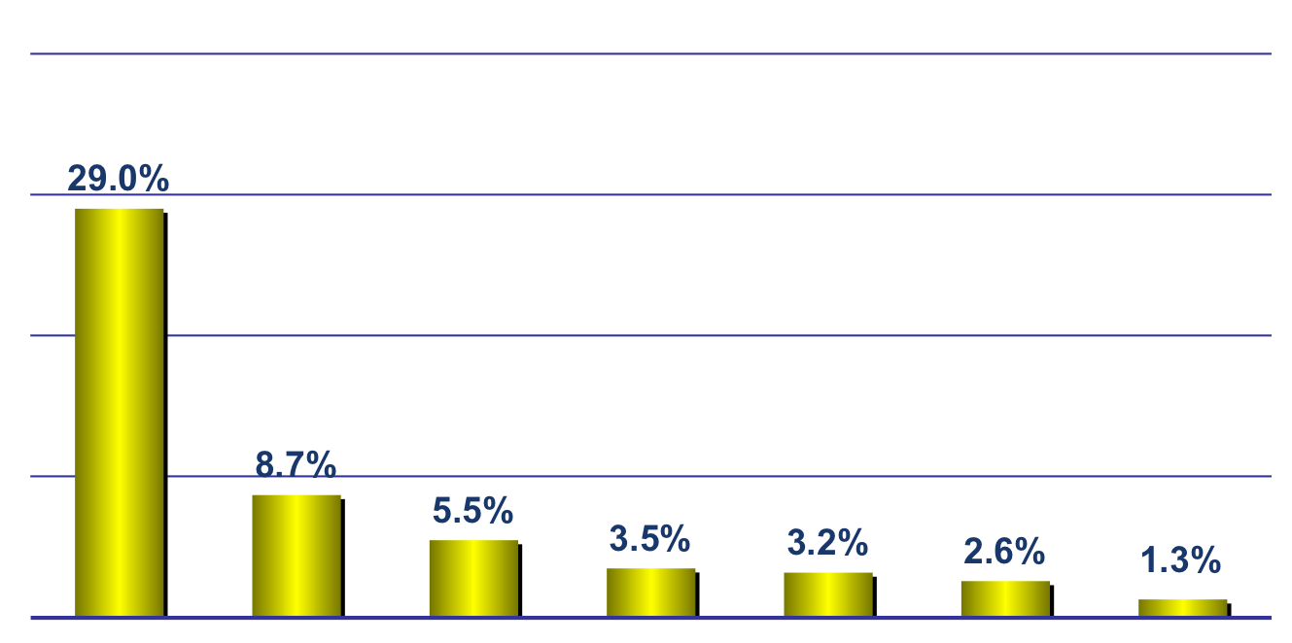
Stent thrombosis rates
According to select patient characteristics
*Antiplatelet
therapy
discontinuation
Prior
brachy
Renal
failure
Bifurcations
ULM
Diabetes
UA
*Premature discontinuation.
*Iakovou et al. JAMA. 2005;293:2126-2130.

Slide 52
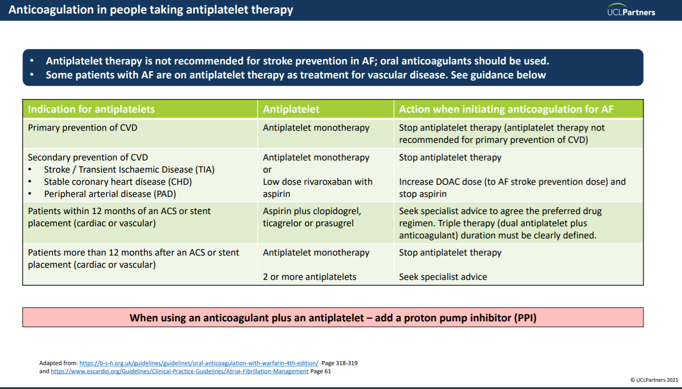

Slide 53
What about gastroprotection?
People are at high risk of gastrointestinal (GI) adverse effects with antiplatelet treatment if the following risk factors are present:
  High dose of aspirin
  Older age, especially aged over 70 years
  History of gastroduodenal ulcer, GI bleeding, or gastroduodenal perforation
  Helicobacter pylori infection
  Concomitant use of medicines that are known to increase the risk of GI bleeds

Slide 54
Beta-blockers
Reduce mortality by up to 45% post-MI
Circulation 1983 Jun;67(6 Pt 2):I49-53; JAMA.1982;247(12):1707-1714
  control heart rate
  improve blood supply
  reduce cardiac workload, therefore reducing oxygen requirements
Also useful for preventing episodes of angina
Titrate to maximum tolerated or target dose (eg bisoprolol 10mg daily)
Continue for at least 12 months- indefinitely if HFrEF
Side effects:
    hypotension, bradycardia, lethargy / fatigue

Slide 55
ACE-I : CV risk reduction
Improved outcome post ACS with or without HF:
With HF studies: AIRE, GISSI-3 and without HF:
Ramipril- HOPE study NEJM 2000; 342: 145-153
  25% reduction in CV death in pts with
    Any CV disease or diabetes plus one cardiac risk factor (high BP, smoking, high cholesterol)
Similar data for Perindopril in EUROPA Lancet 2003; 362: 782-788
Use ARB if ACEi not tolerated (dry cough)
Titrate to maximum tolerated or target dose (e.g ramipril 5mg bd)
Complete dose titration within 4-6 weeks of discharge
Monitor renal function, electrolytes and BP within 1-2 weeks of each dose change
Adverse effect: symptomatic hypotension

Slide 56
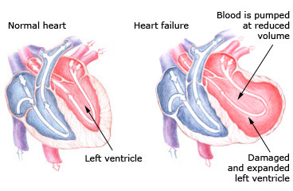
LV Function

Slide 57
Aldosterone antagonists
Patients with symptoms and signs of heart failure will require an early assessment of LV function
Those with symptoms or signs of heart failure and LVSD should be offered a licensed aldosterone antagonist within 3–14 days of the acute MI
Monitor renal function, electrolytes throughout therapy
  If hyperkalaemia is an issue halve dose or stop drug
  If gynaecomastia with spironolactone – consider eplerenone
Notes:
These are the other key recommendations about drug therapy:
‘For patients who have had an acute MI and who have symptoms and/or signs of heart failure and left ventricular systolic dysfunction, treatment with an aldosterone antagonist licensed for post-MI treatment should be initiated within 3–14 days of the MI, preferably after ACE inhibitor therapy.’ (page 7, NICE guideline)
Patients who have recently had an acute MI and have clinical heart failure and left ventricular systolic dysfunction, but who are already being treated with an aldosterone antagonist for a concomitant condition (for example, chronic heart failure), should continue with the aldosterone antagonist or an alternative, licensed for early post-MI treatment.
For patients who have had a proven MI in the past and heart failure due to left ventricular systolic dysfunction, treatment with an aldosterone antagonist should be in line with ‘Chronic heart failure’ (NICE clinical guideline 5). (page 20, NICE guideline)

Slide 58
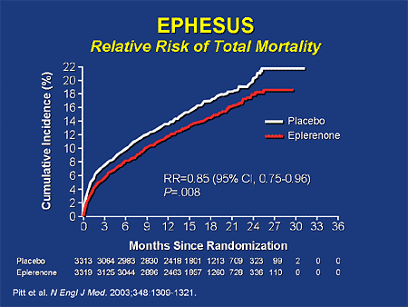

Slide 59
Does Doris require an aldosterone antagonist?
Yes
No
Depends how long since MI
Depends on LVEF

Slide 60
Summary
Multiple therapies are required to optimise outcomes in CVD
    initiation of therapy
    dose optimisation after discharge
    choice of agent
    Monitoring – renal function, blood pressure, heart rate
Therapy should be used to manage both symptoms and CV risk
Patients need to understand why they need multiple therapies
Regimens should be tailored to the individual
Adverse effects should be dealt with quickly

Slide 61
References for ACS
NICE Acute Coronary Syndromes: https://www.nice.org.uk/guidance/ng185
AAC/NHSE: https://www.england.nhs.uk/aac/wp-content/uploads/sites/50/2020/04/lipid-management-pathway-guidance.pdf
https://www.england.nhs.uk/aac/wp-content/uploads/sites/50/2020/08/Statin-Intolerance-Pathway-NEW.pdf

